Slide 1

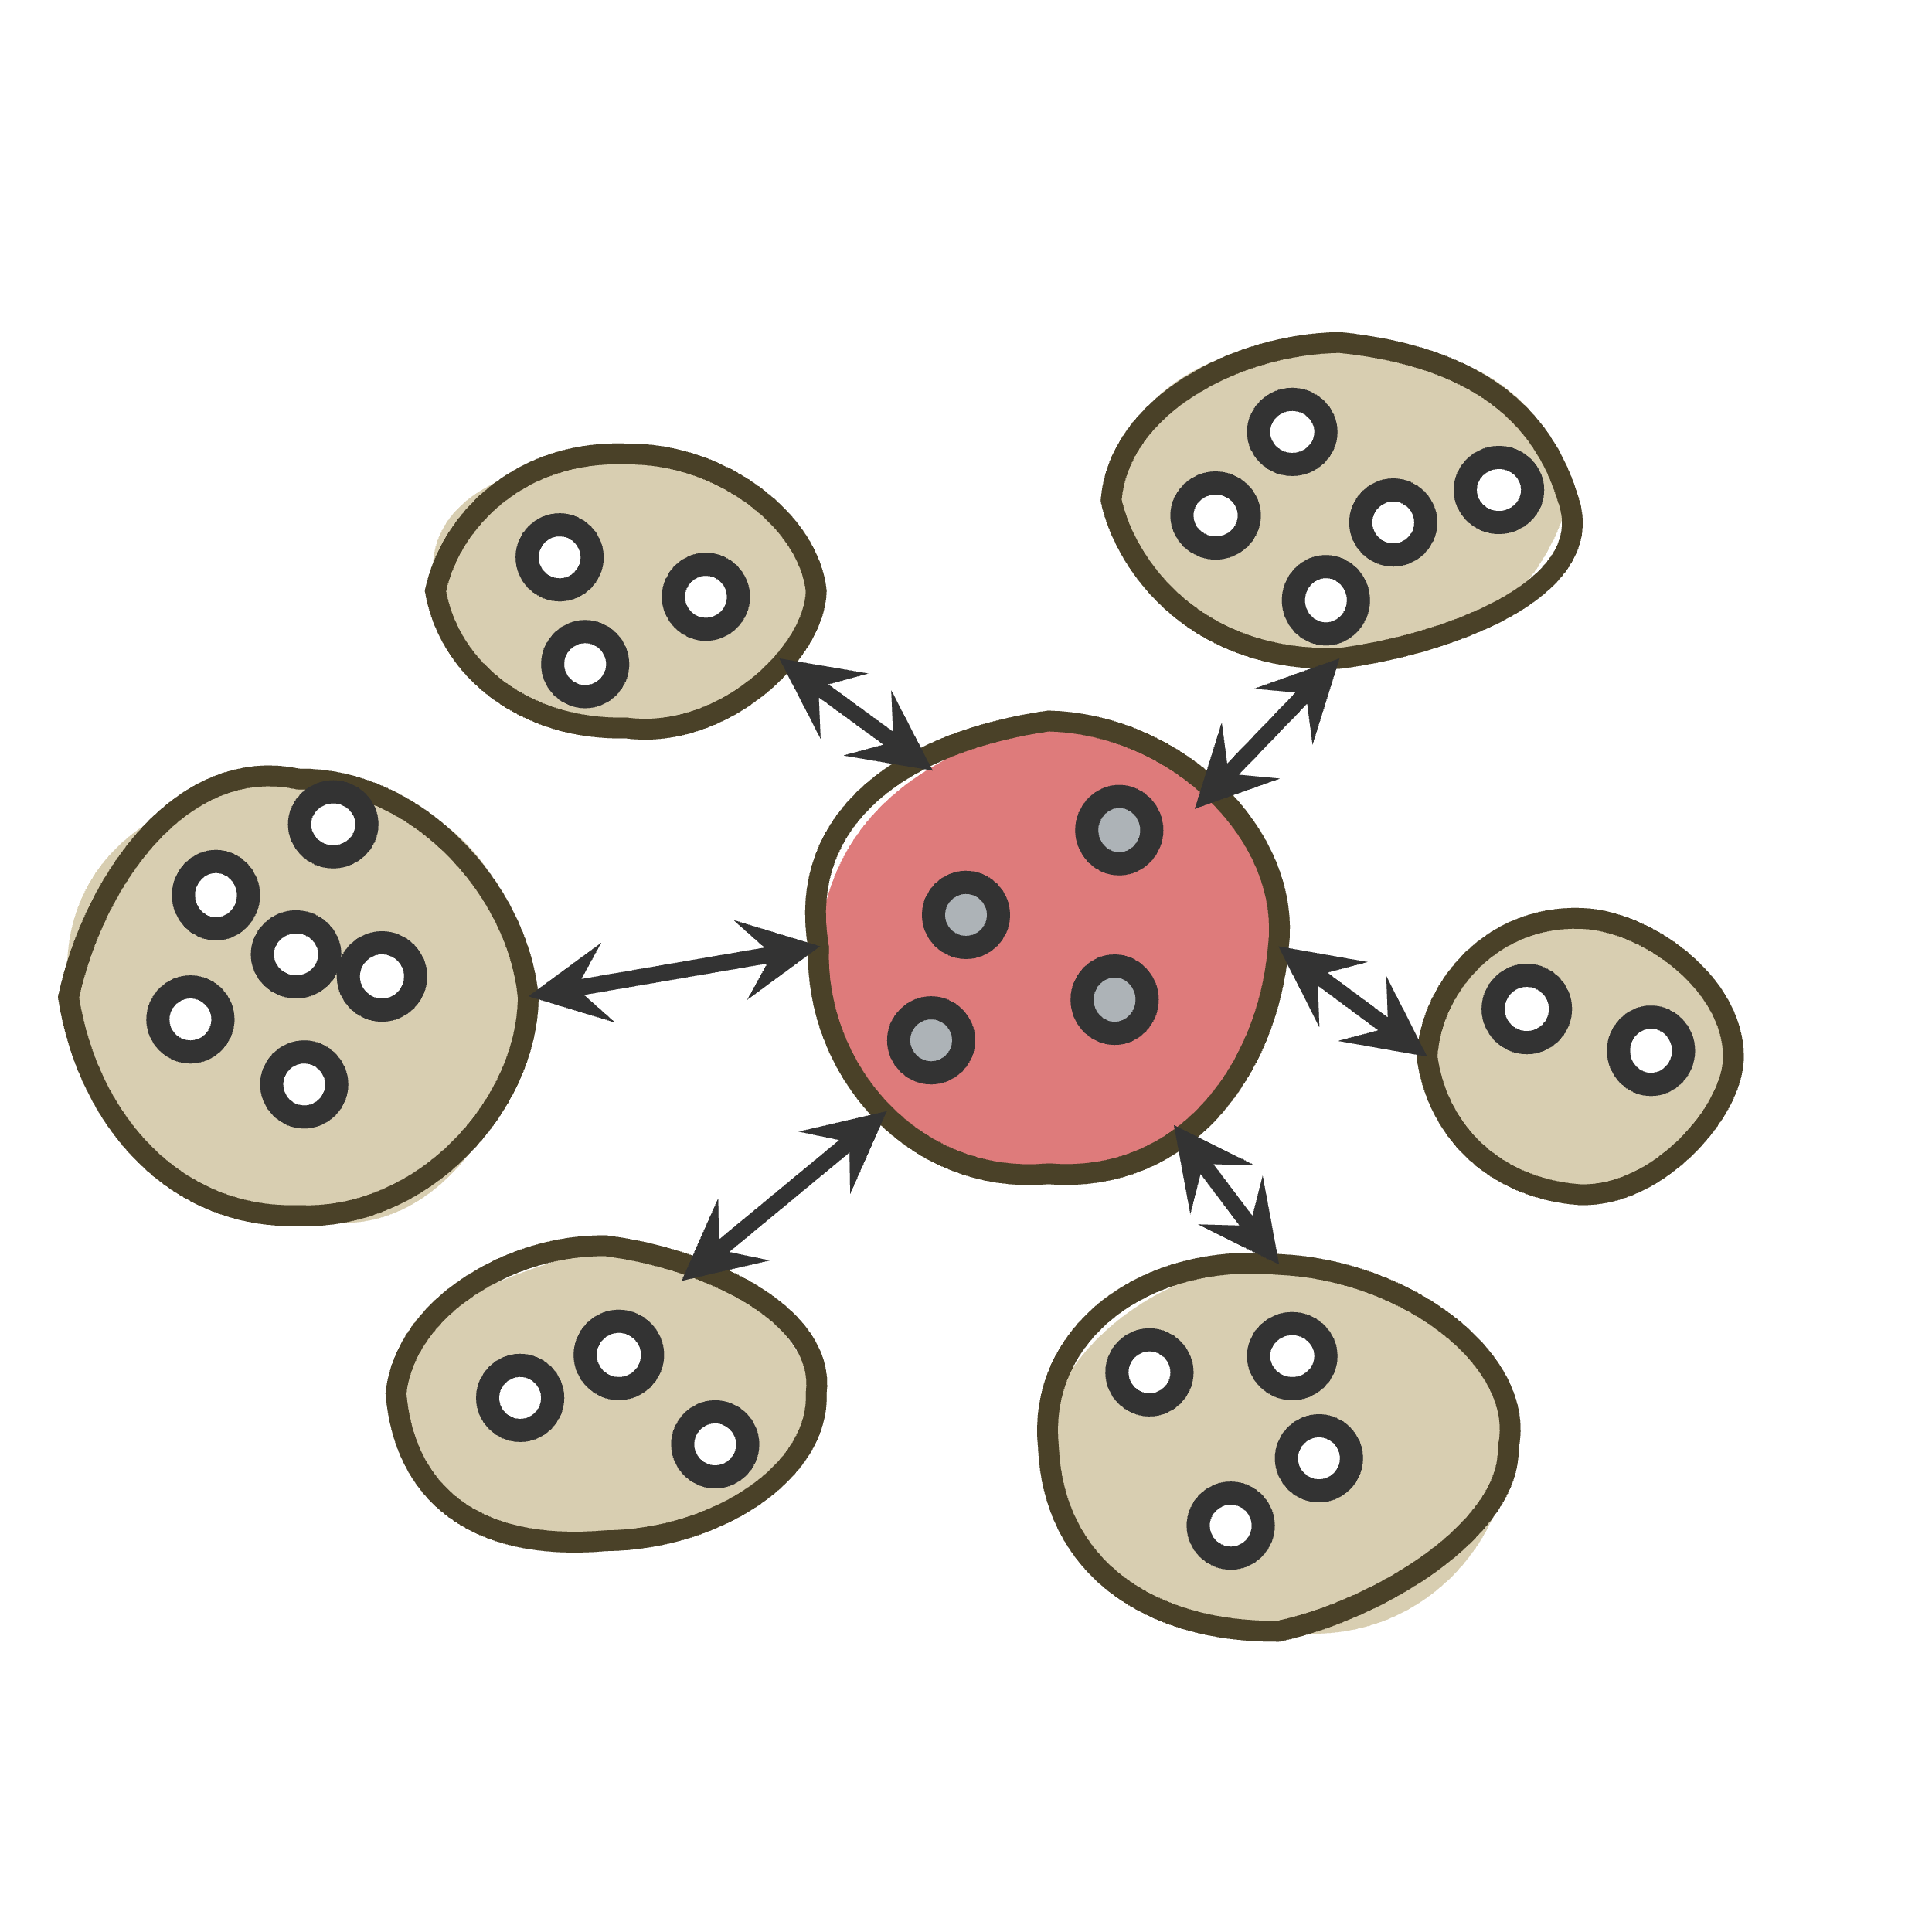

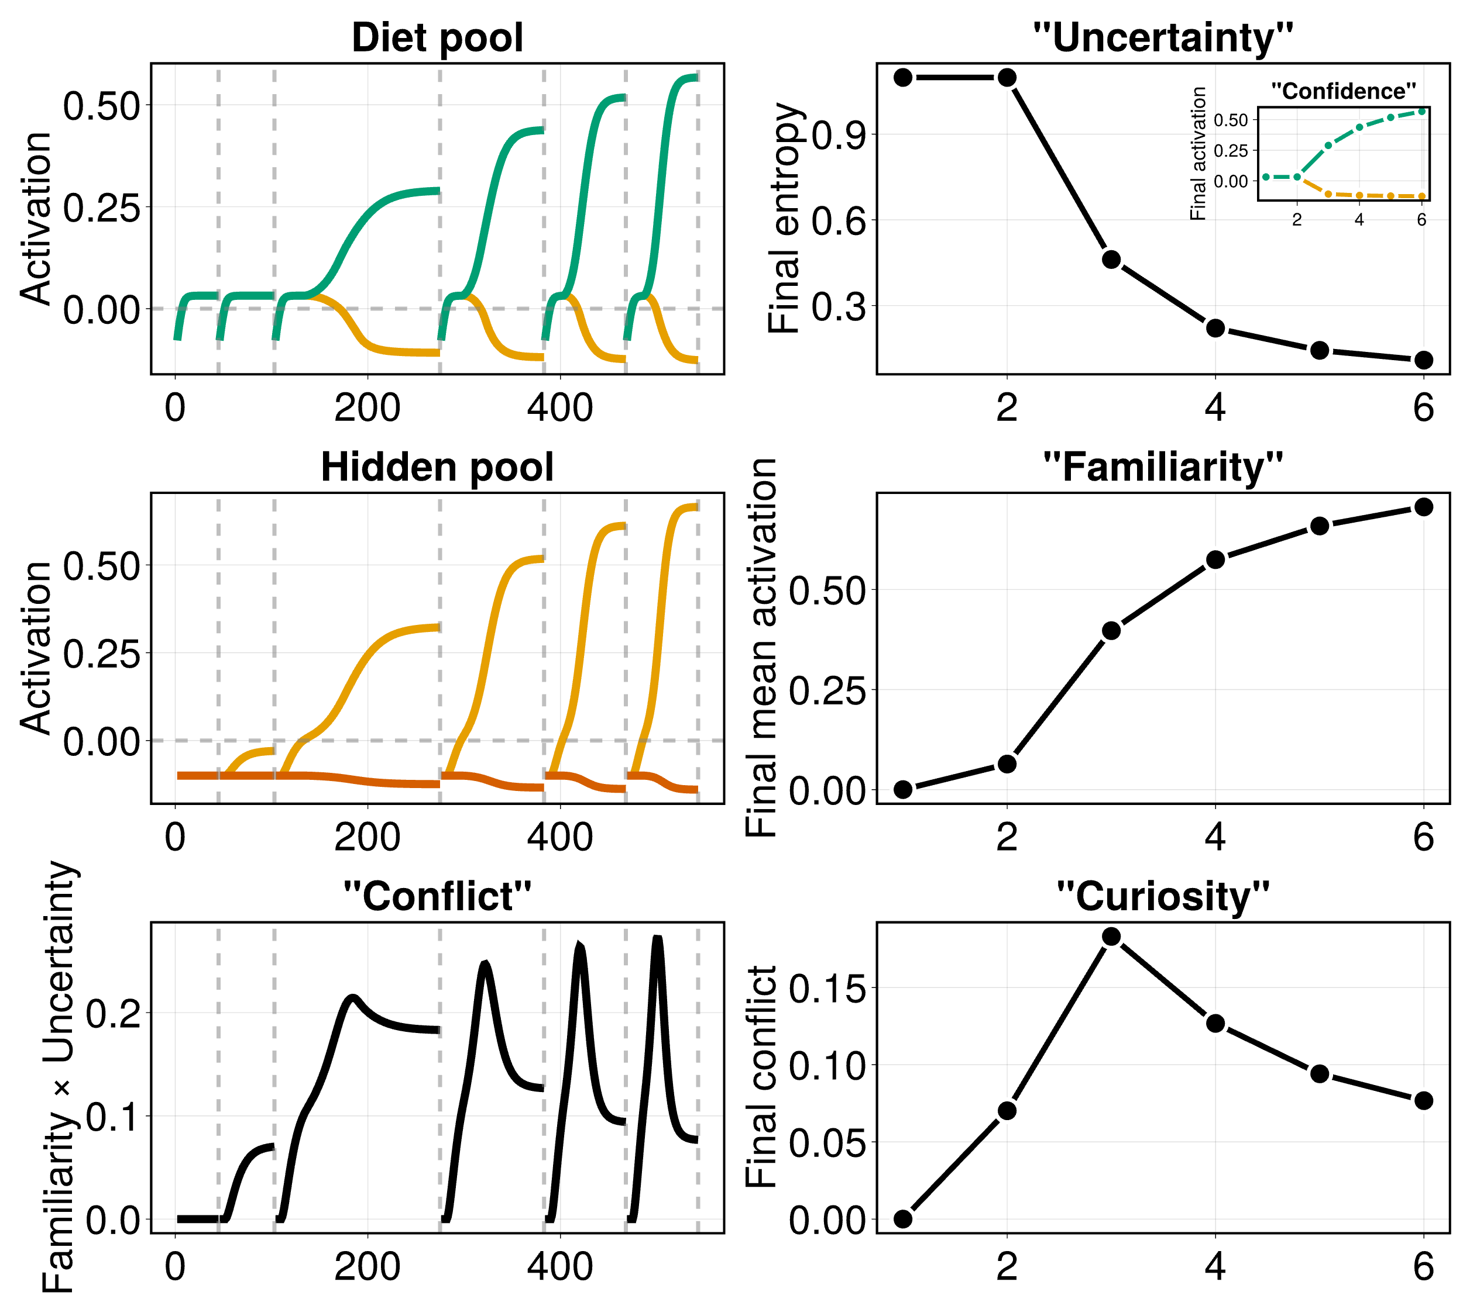
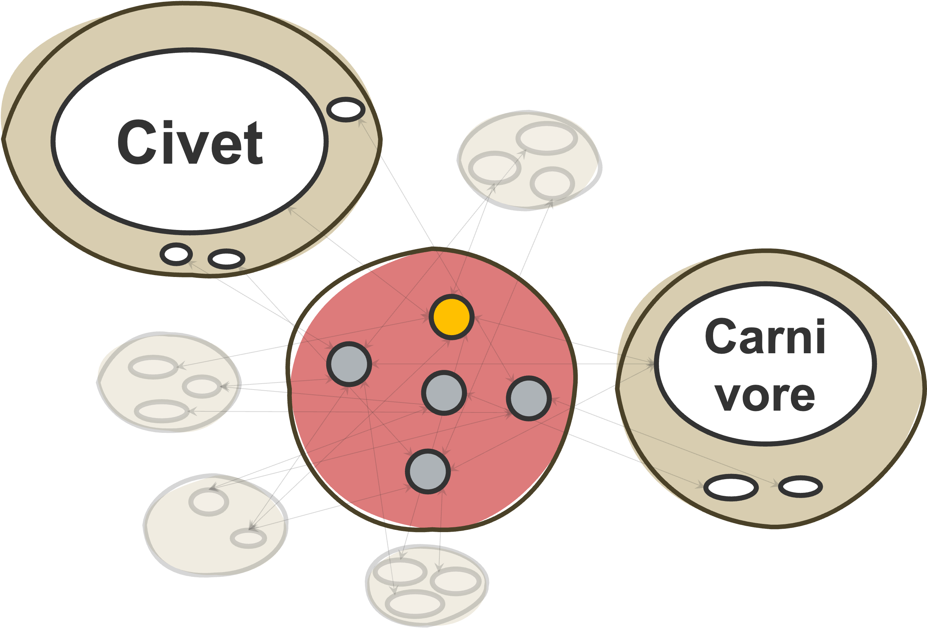

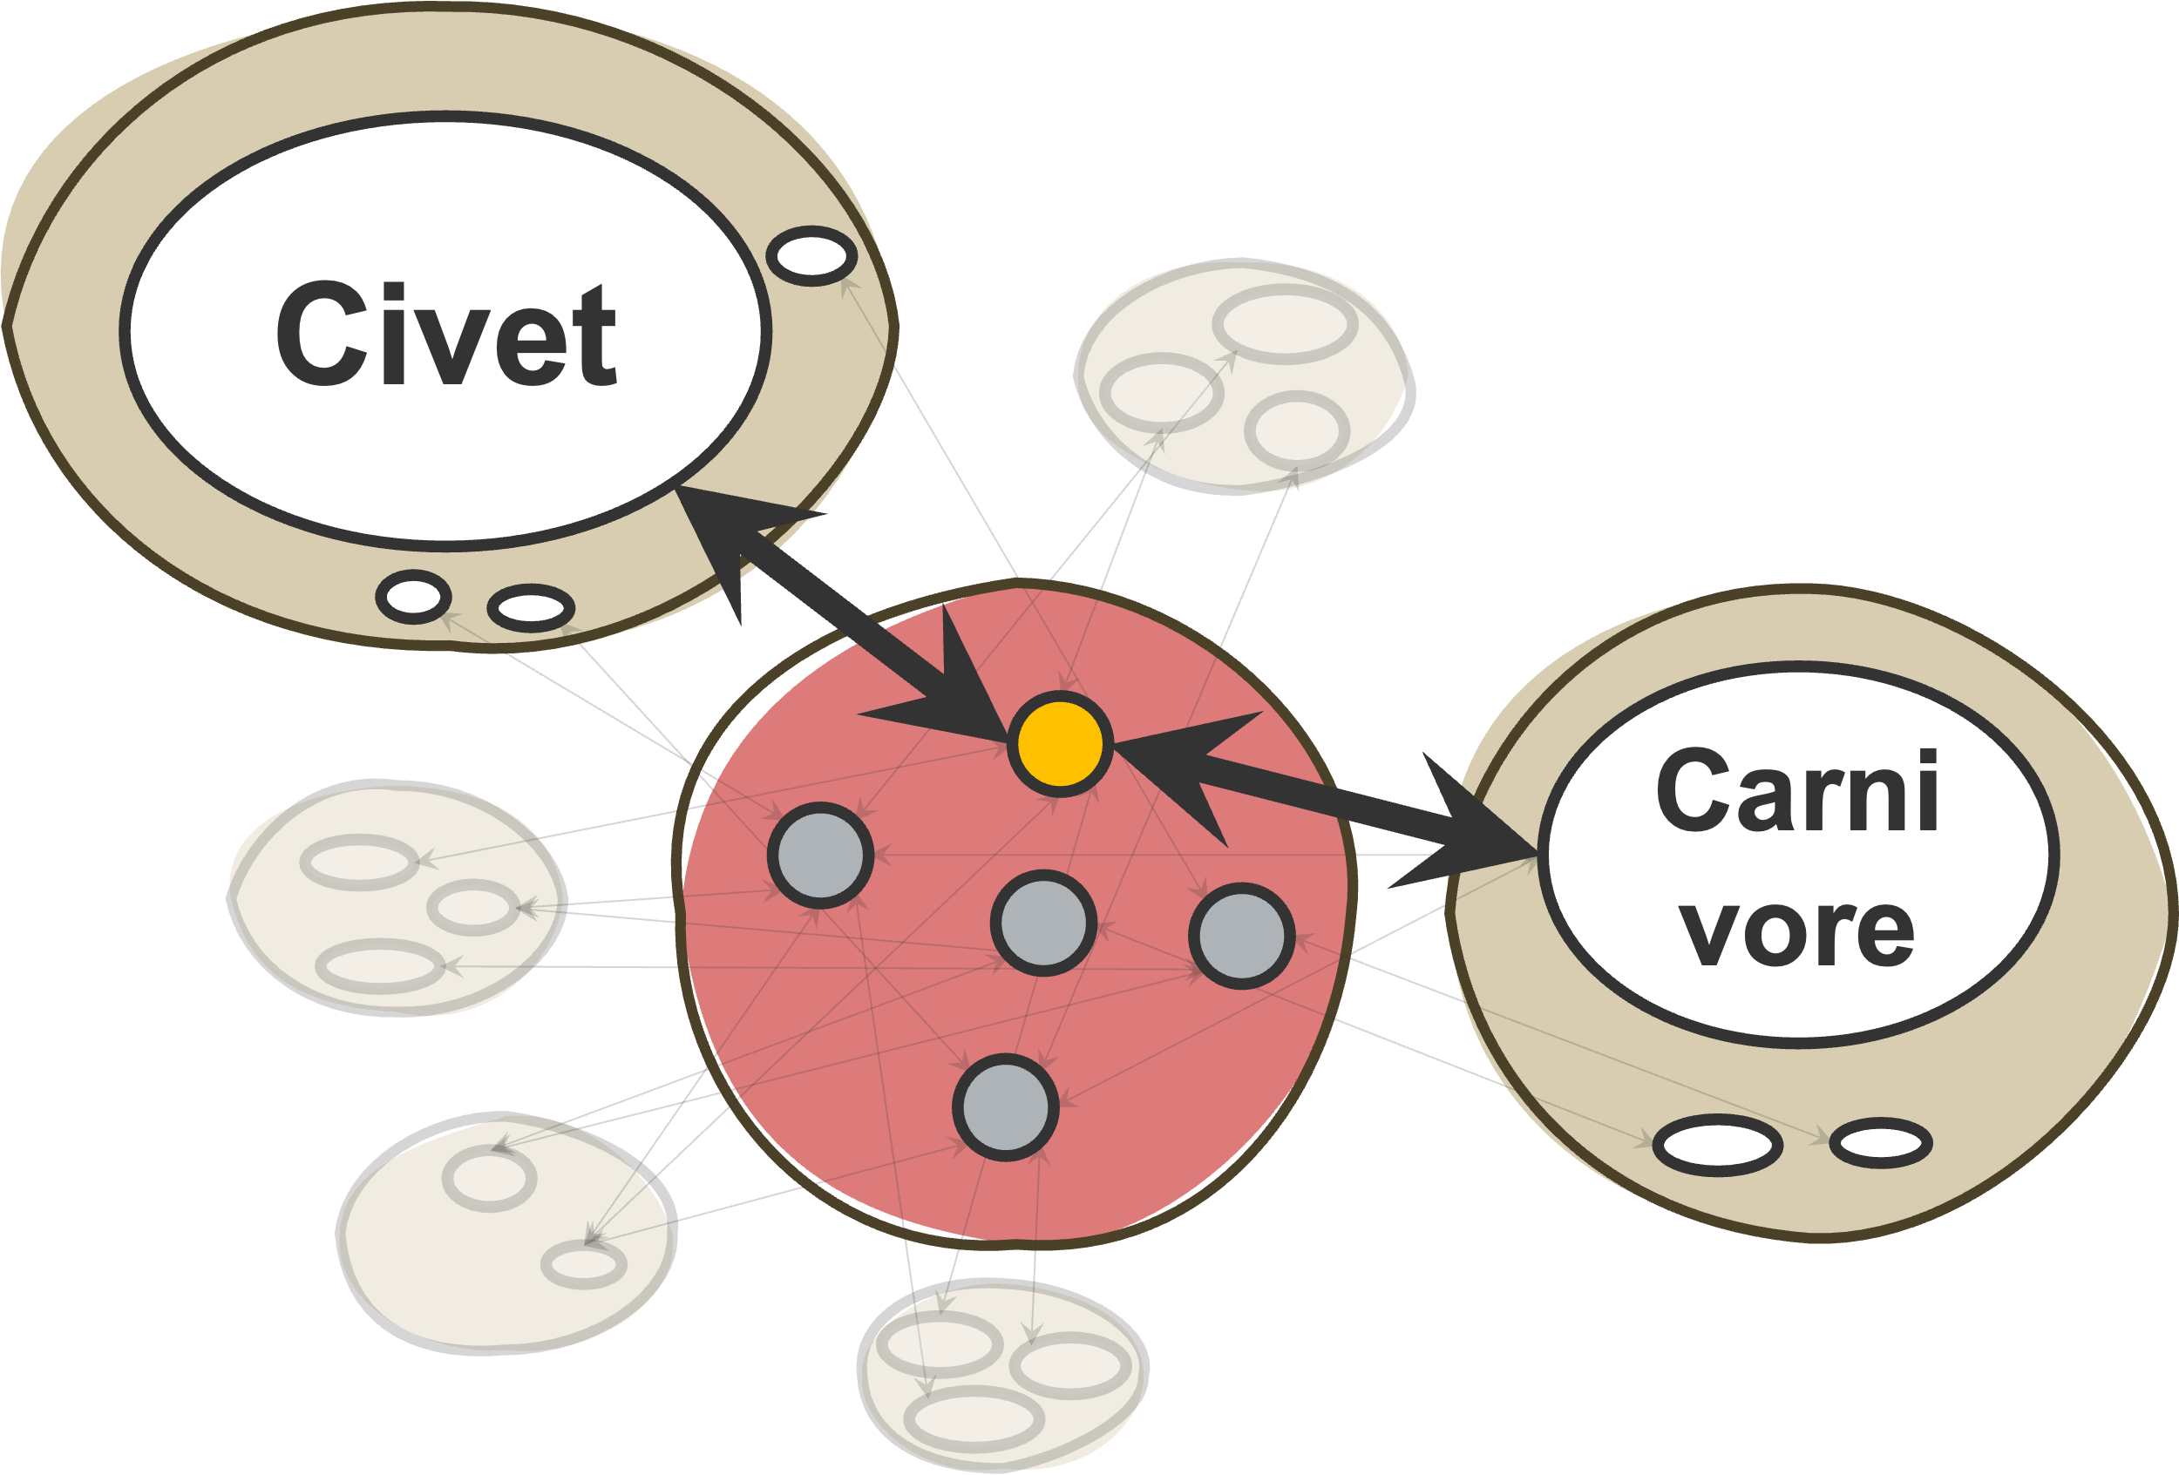
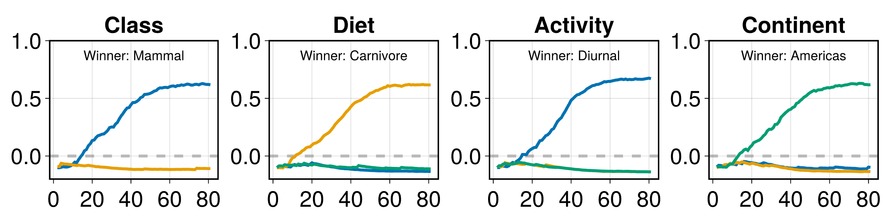
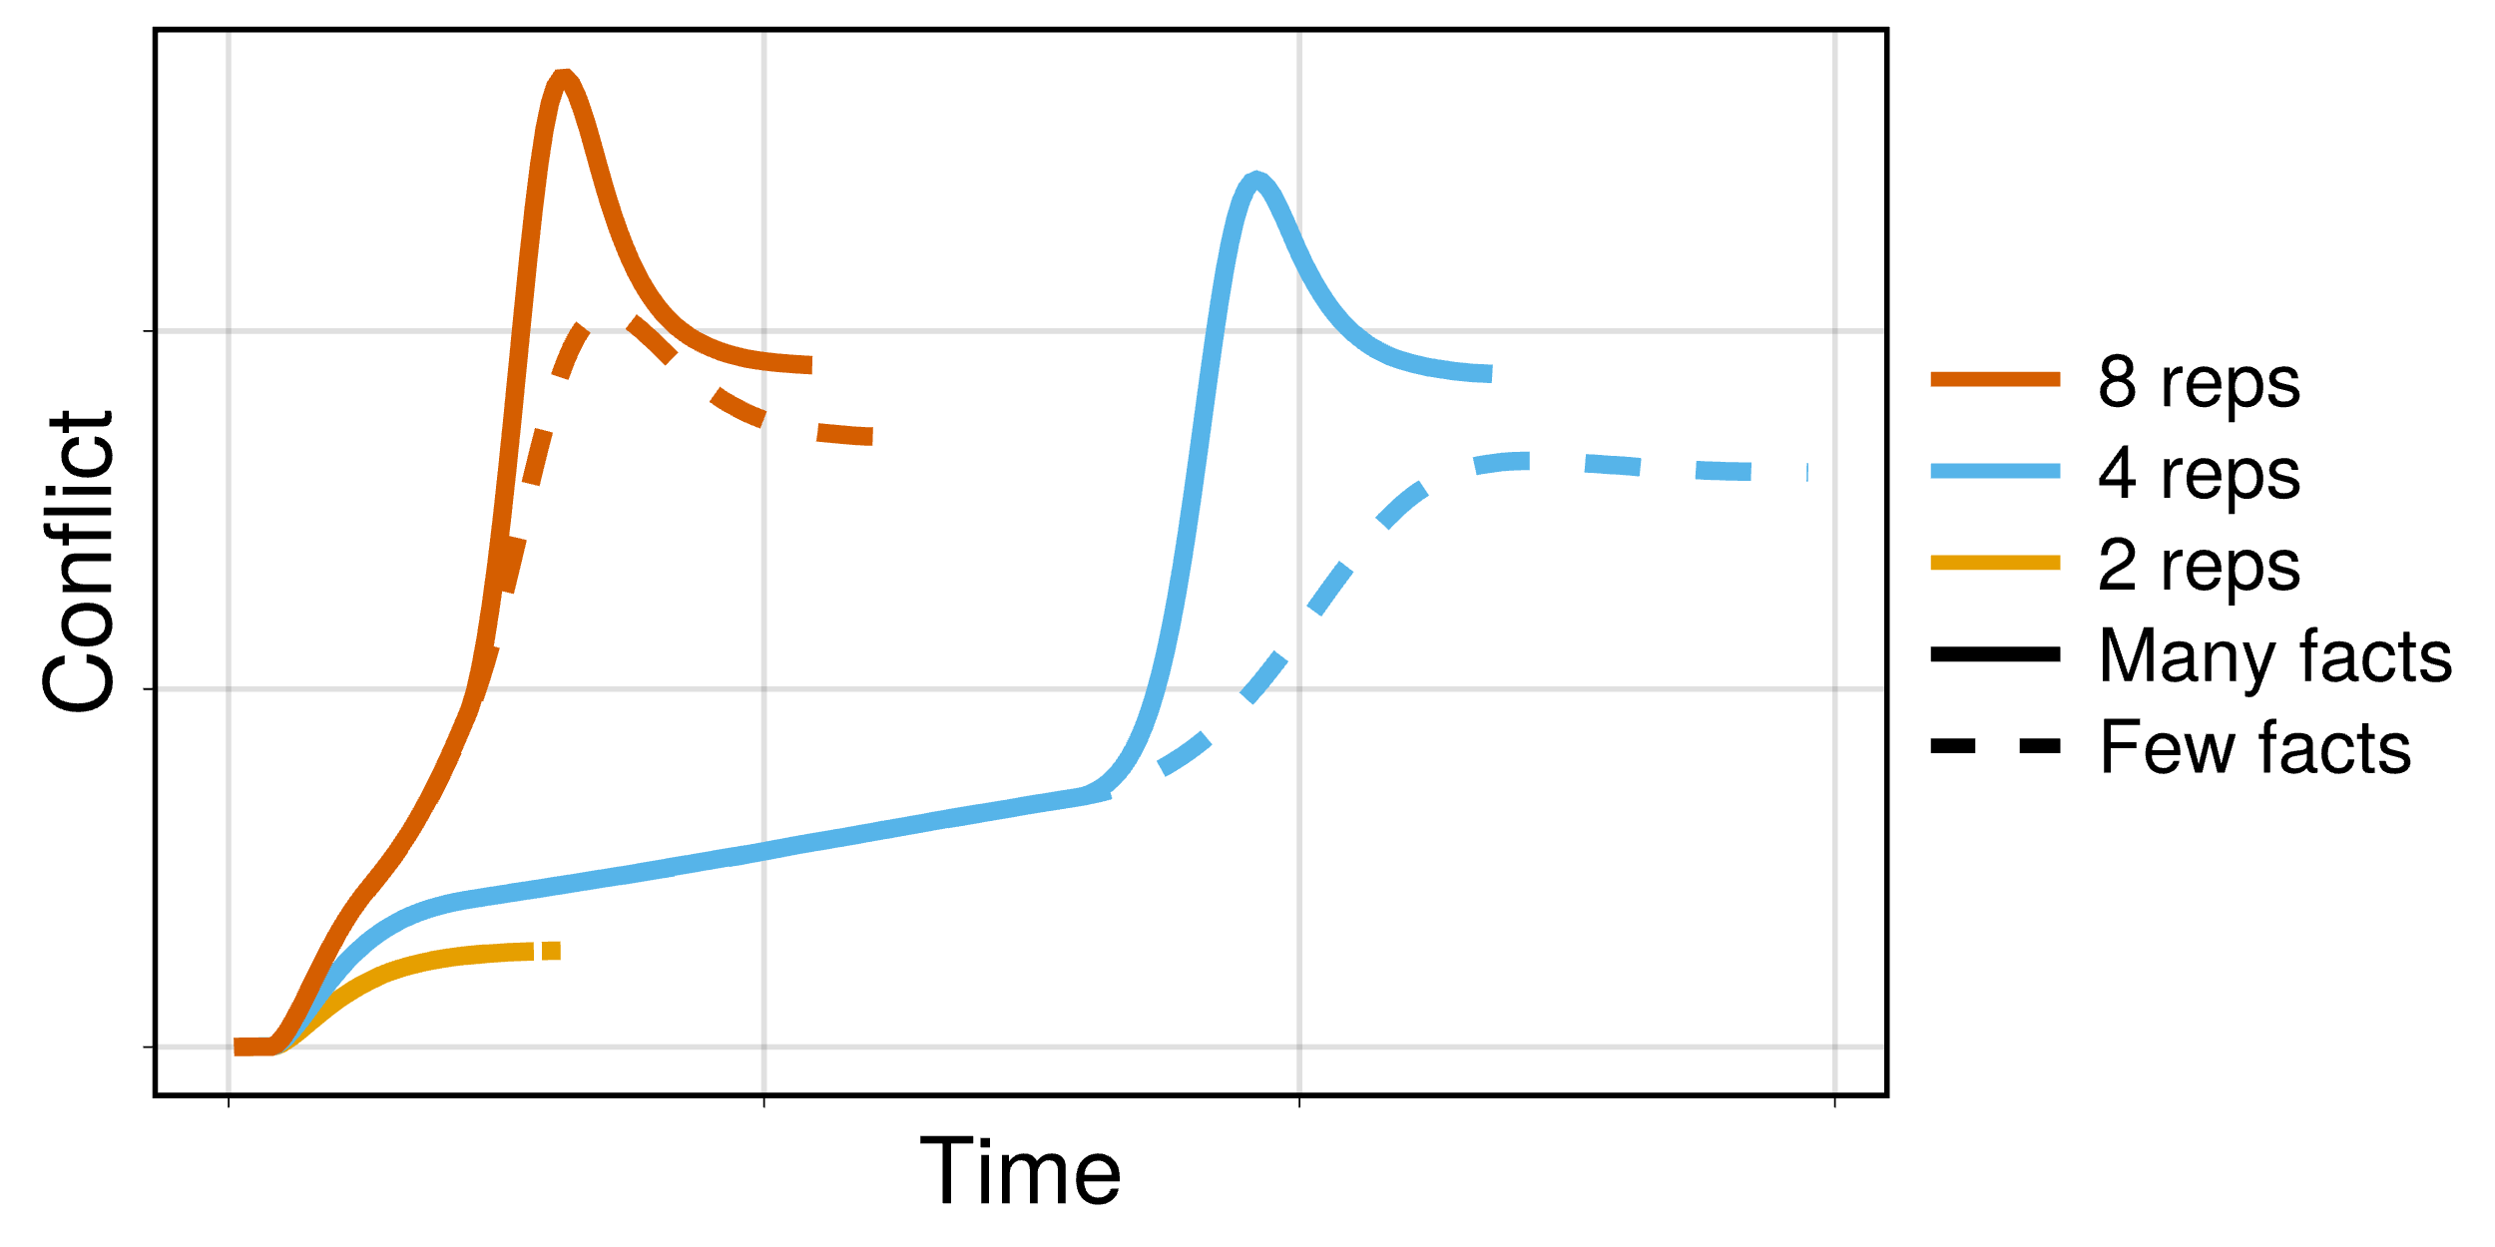
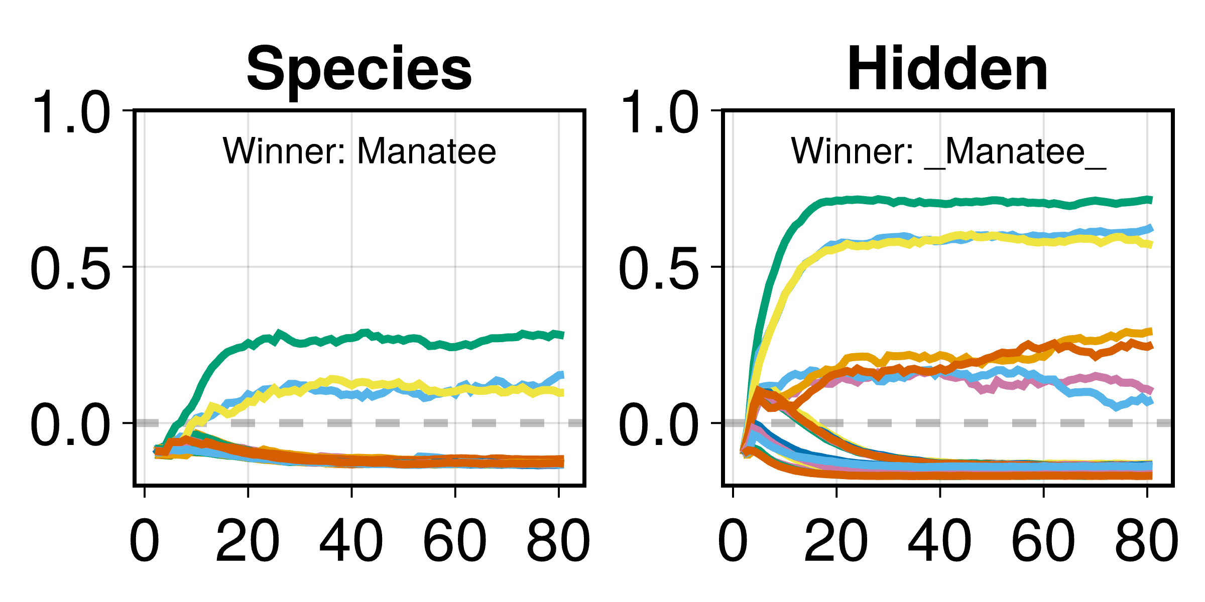
In search of origins of curiosity
Alexandr Ten & Aditya Singh
What are the cognitive origins of curiosity?
Inverted U between knowledge and curiosity
I so wish I knew!
What does the civet eat?
Where do manatees sleep?
pfft.. who cares?
Connectionist model of associative memory
Interactive Activation and Competition (IAC) Network
Species | Class | Diet | Habitat | Activity | Continent
Civet | Mammal | Carnivore | Terrestrial | Nocturnal | Africa
Manatee | Mammal | Herbivore | Aquatic | Diurnal | Americas
Tiger | Mammal | Carnivore | Terrestrial | Diurnal | Eurasia
Great potoo | Avian | Omnivore | Arboreal | Nocturnal | Americas
Green pigeon | Avian | Herbivore | Arboreal | Diurnal | Africa
... | ... | ... | ... | ... | ...
Civet
Pigeon
Potoo
Africa
Eurasia
Tiger
Manatee
Americas
Nocturnal
Carnivore
Episode 1
(No knowledge)
Episode 3
(Incomplete knowledge)
Episode 6
(Perfect knowledge)
Diurnal
Herbivore
Crepuscular
Omnivore
Generating novel predictions
Avian
Terrestrial
Examples:
Deliberation ~ Familiarity + Familiarity²
Curiosity ~ Familiarity + Retrieval
Mammal
Arboreal
Aquatic
Civet
Mammal
Civet
Mammal
Civet
Mammal
Civet
Mammal
Terrestrial
Terrestrial
Terrestrial
Terrestrial
What do you know about the European beaver?
Carnivore
Nocturnal
Carnivore
Nocturnal
Carnivore
Nocturnal
Carnivore
Nocturnal
Africa
Africa
Africa
Africa
Civet
Mammal
Terrestrial
Carnivore
Nocturnal
Africa
What herbivorous aquatic mammal species native to Americas do you know that is mostly active during the day?
Howler Monkey
Mammal
Herbivore
Arboreal
Diurnal
Americas
Key literature
Berlyne, D. E. (1960). Conflict, arousal, and curiosity. McGraw-Hill Book Company.
Brooks, G., Yang, H., & Köhler, S. (2021). Feeling-of-knowing experiences breed curiosity. Memory, 29(2).
Koriat, A. (1993). How do we know that we know? The accessibility model of the feeling of knowing. Psychological review, 100(4).
McClelland, J. L. (1981). Retrieving general and specific information from stored knowledge of specifics. In Proceedings of the Third Annual Conference of the Cognitive Science Society.
Metcalfe, J., Schwartz, B. L., & Eich, T. S. (2020). Epistemic curiosity and the region of proximal learning. Current opinion in behavioral sciences, 35.
Ten, A., Oudeyer, P-Y., Sakaki, M., & Murayama, K. (in review). The curious U: Integrating theories linking knowledge and information-seeking behavior.
Coati
Mammal
Omnivore
Terrestrial
Diurnal
Americas

